Slide 1

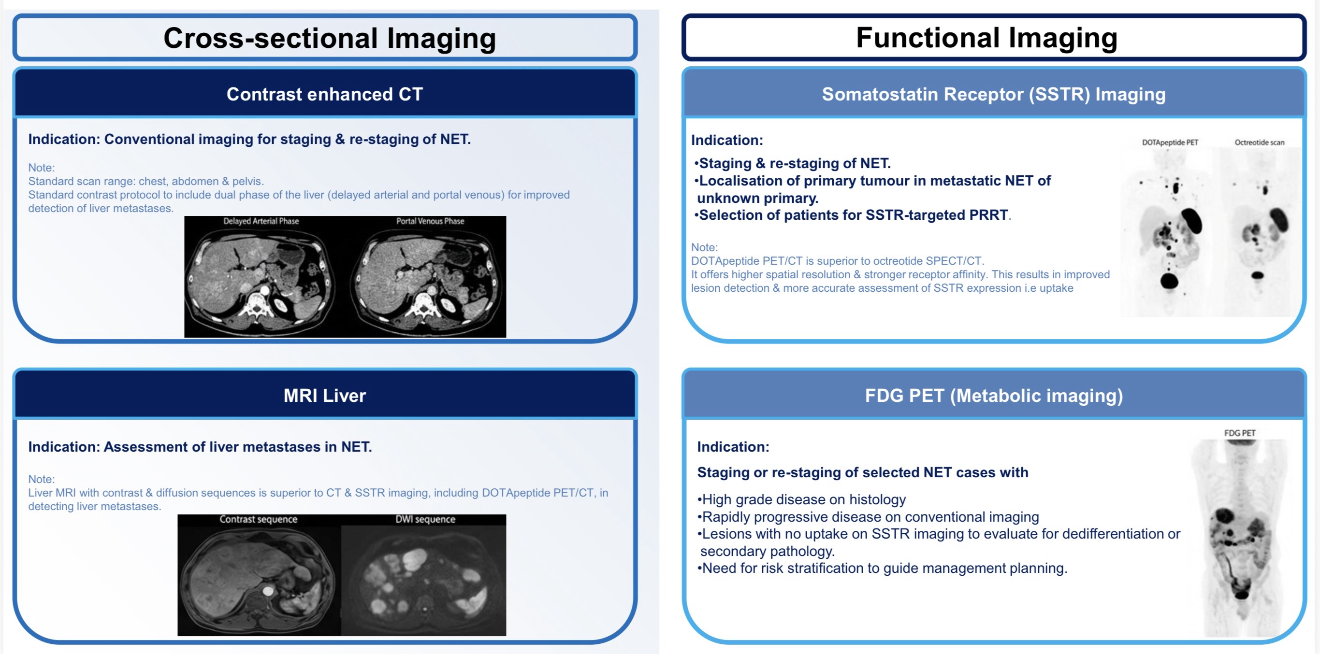
  UKINETS bitesize guidance
  Imaging Protocols and Indications in NETs
Title
Author: Dr Mohamed El-Sayed Date completed: 09/06/2026 www.ukinets.org

Slide 2
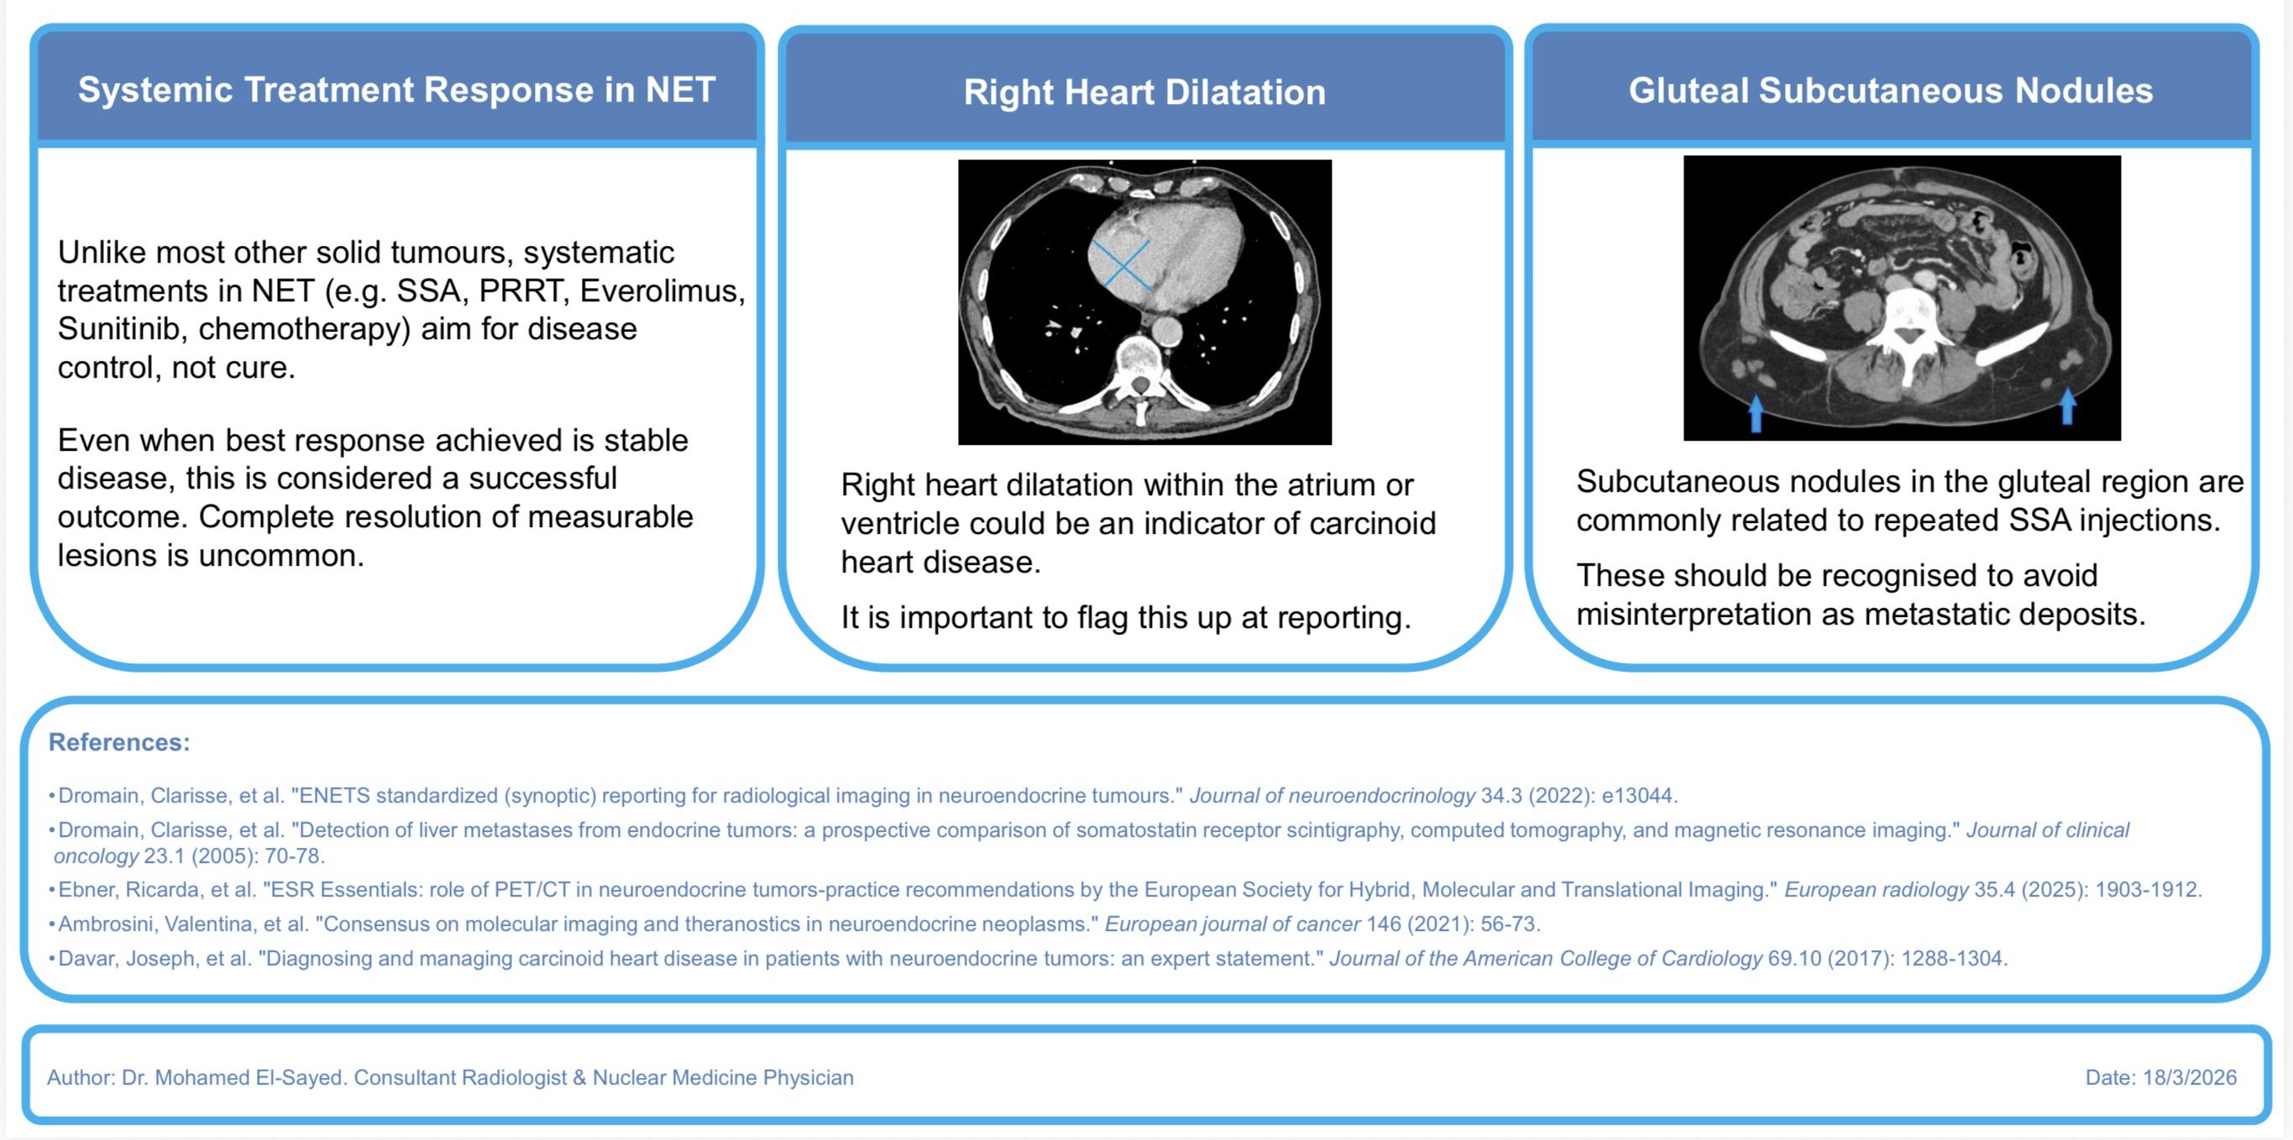
  UKINETS bitesize guidance
  Imaging Protocols and Indications in NETs
  Important Reporting Considerations
Title
Author: Dr Mohamed El-Sayed Date completed: 09/06/2026 Review date: 09/06/2028 www.ukinets.org

